Slide 1
WINDOWS FUNDEMANTALS

Slide 2
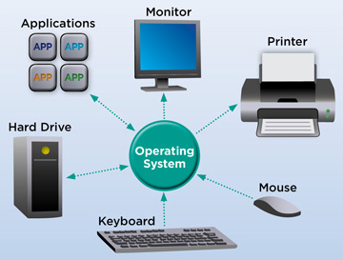
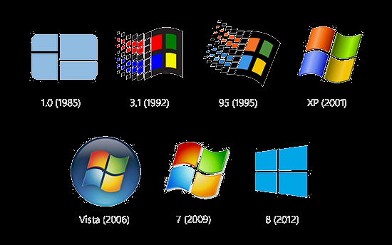
Operating system
Simple Batch System
Multiprogramming Batch System
Multiprocessor System
Desktop System
Distributed Operating System
Clustered System
Realtime Operating System
1. Ease of use | High resource requirements
2. Backwards compatibility | Closed Source
3. Support for new hardware | Poor security & Poor support for older hardware
4. Better Stability | Extortionist prices
5. It supports secure boot | Poor remote access
6. It allows many programs to operate at the same time | Backwards incompatible file formats

Slide 3
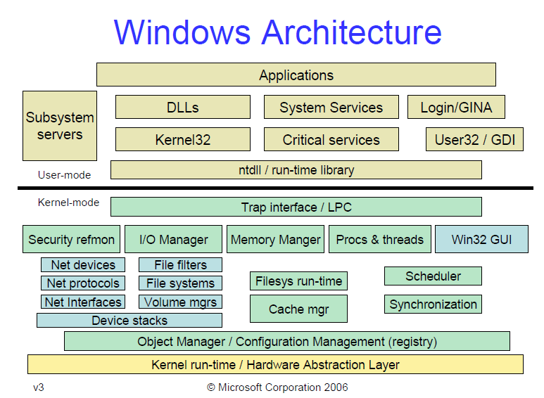

Slide 4
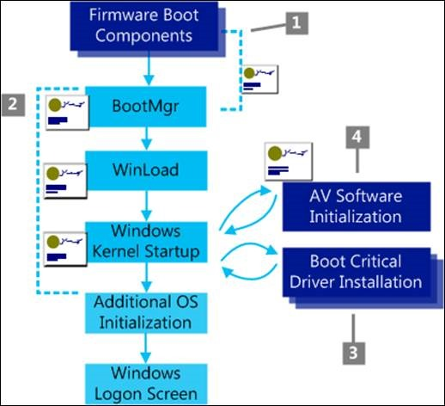
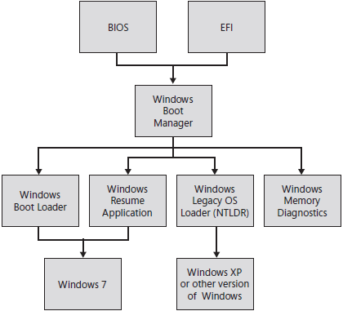
Windows Booting Process

Slide 5
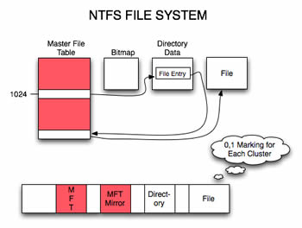
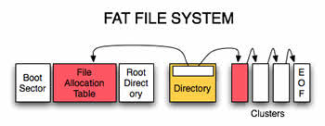
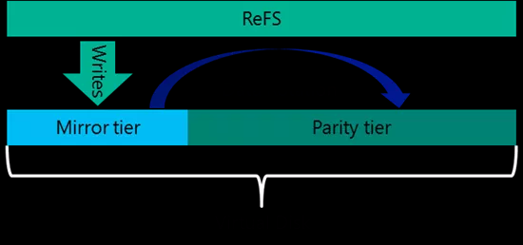

File System

Slide 6
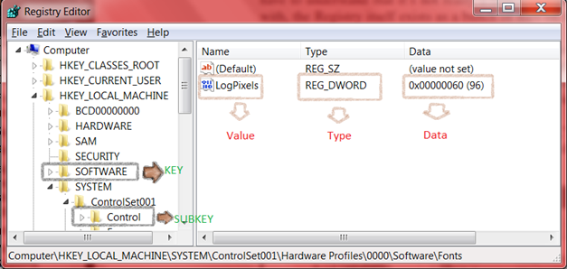
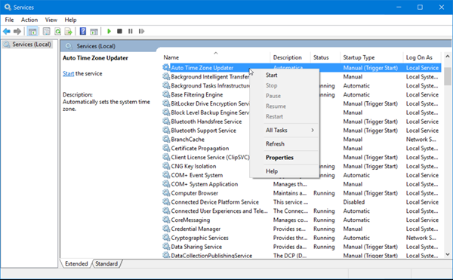
Management Mechanisms
Registry
Services
The Windows Registry is a collection of databases of configuration settings in Microsoft Windows operating systems
The Service Control Manager (SCM) is the key component of the operating system responsible for providing a management interface to services.

Slide 7
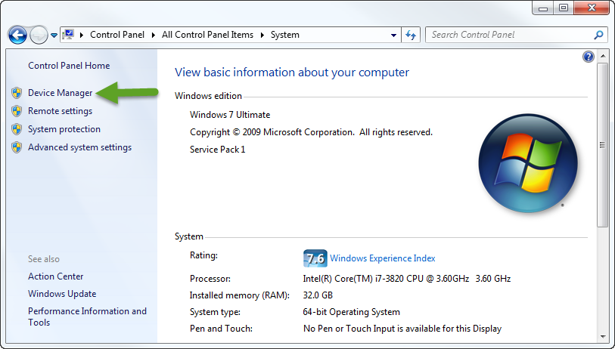
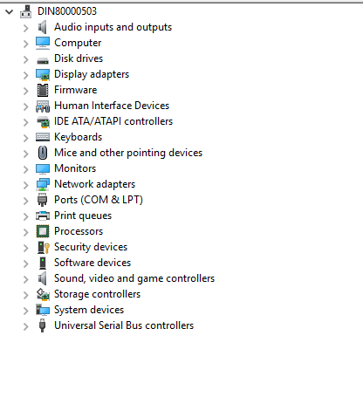
Device Management
Device Driver
Power Manager States
Suspended
Resuming
Screen Off
On
Backlight Off
User Idle

Slide 8
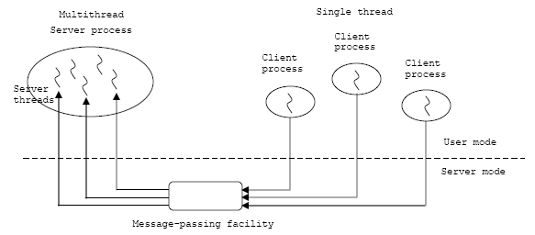
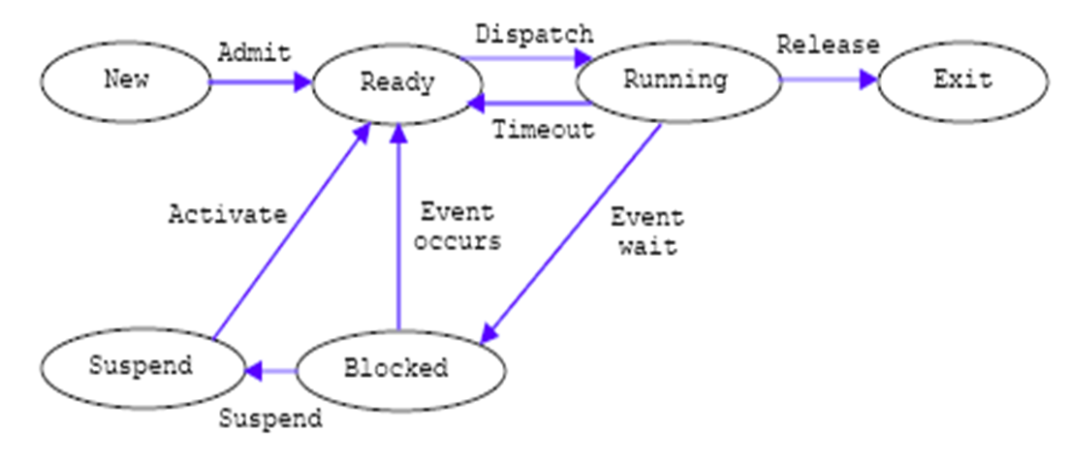
Process Management
Process
A collection of one or more threads and associated system resources such as memory, open files and devices.
Threads
The smallest sequence of programmed instructions
Process States

Slide 9
Memory Management
Virtual Memory - A virtual memory management systems maps the virtual addresses of the pages with
the physical addresses of the pages after the pages of the program has been loaded at RAM.
Virtual Address Space - The address space for each process is private and cannot be accessed by other
processes unless it is shared. A virtual address does not represent the actual physical location of an object in memory.
Paging – It is a memory management scheme that eliminates the need for contiguous allocation of physical memory.
Memory Pool - It also called fixed-size blocks allocation, is the use of pools for memory management that allows dynamic memory allocation.
Paged pool
Non paged pool

